Slide 1

IS-201 – Database
Chapter 7 - Relational Database Design
Part(1) of (6)
DAW MAY THU KYAW
LECTURER
Faculty of Information Science

Slide 2
Outlines
Features of Good Relational Design
Functional Dependencies
Decomposition Using Functional Dependencies

Slide 3
Features of Good Relational Designs
Entity Relationship design provides an excellent starting point for creating a relational database design.
It is possible to generate a set of relation schemas directly from the E-R design.
The goodness (or badness) of the resulting set of schemas depends on how good the E-R design was in the first place.
Now, we shall study precise ways of assessing the desirability of a collection of relation schemas.

Slide 4
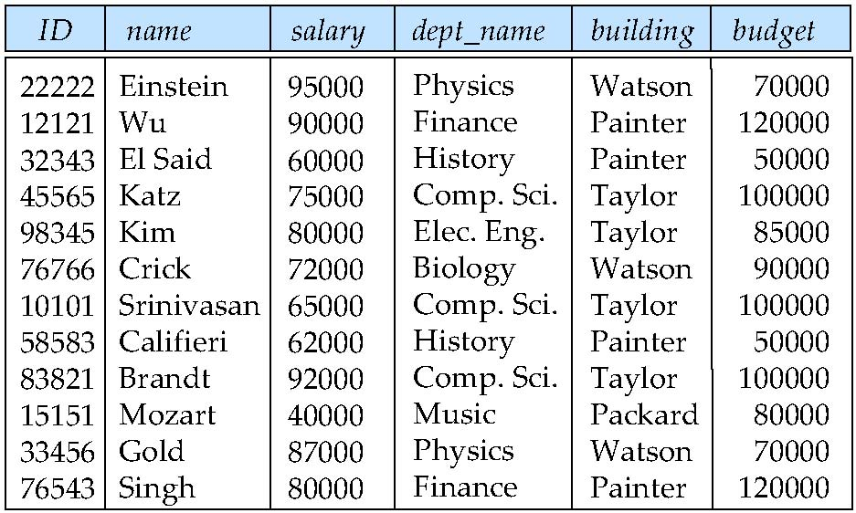
Features of Good Relational Designs
Suppose we combine instructor and department into in_dep, which represents the natural join on the relations instructor and department
There is repetition of information
Need to use null values (if we add a new department with no instructors)

Slide 5
A Combined Schema Without Repetition
Not all combined schemas result in repetition of information
Consider combining relations
sec_class(sec_id, building, room_number) and
section(course_id, sec_id, semester, year)
into one relation
section(course_id, sec_id, semester, year, building, room_number)
No repetition in this case

Slide 6
Decomposition
The only way to avoid the repetition-of-information problem in the in_dep schema is
to decompose it into two schemas – instructor and department schemas.
Not all decompositions are good. Suppose we decompose
employee(ID, name, street, city, salary)
into
employee1 (ID, name)
employee2 (name, street, city, salary)
The problem arises when we have two employees with the same name
The next slide shows how we lose information -- we cannot reconstruct the original
employee relation -- and so, this is a lossy decomposition.

Slide 7
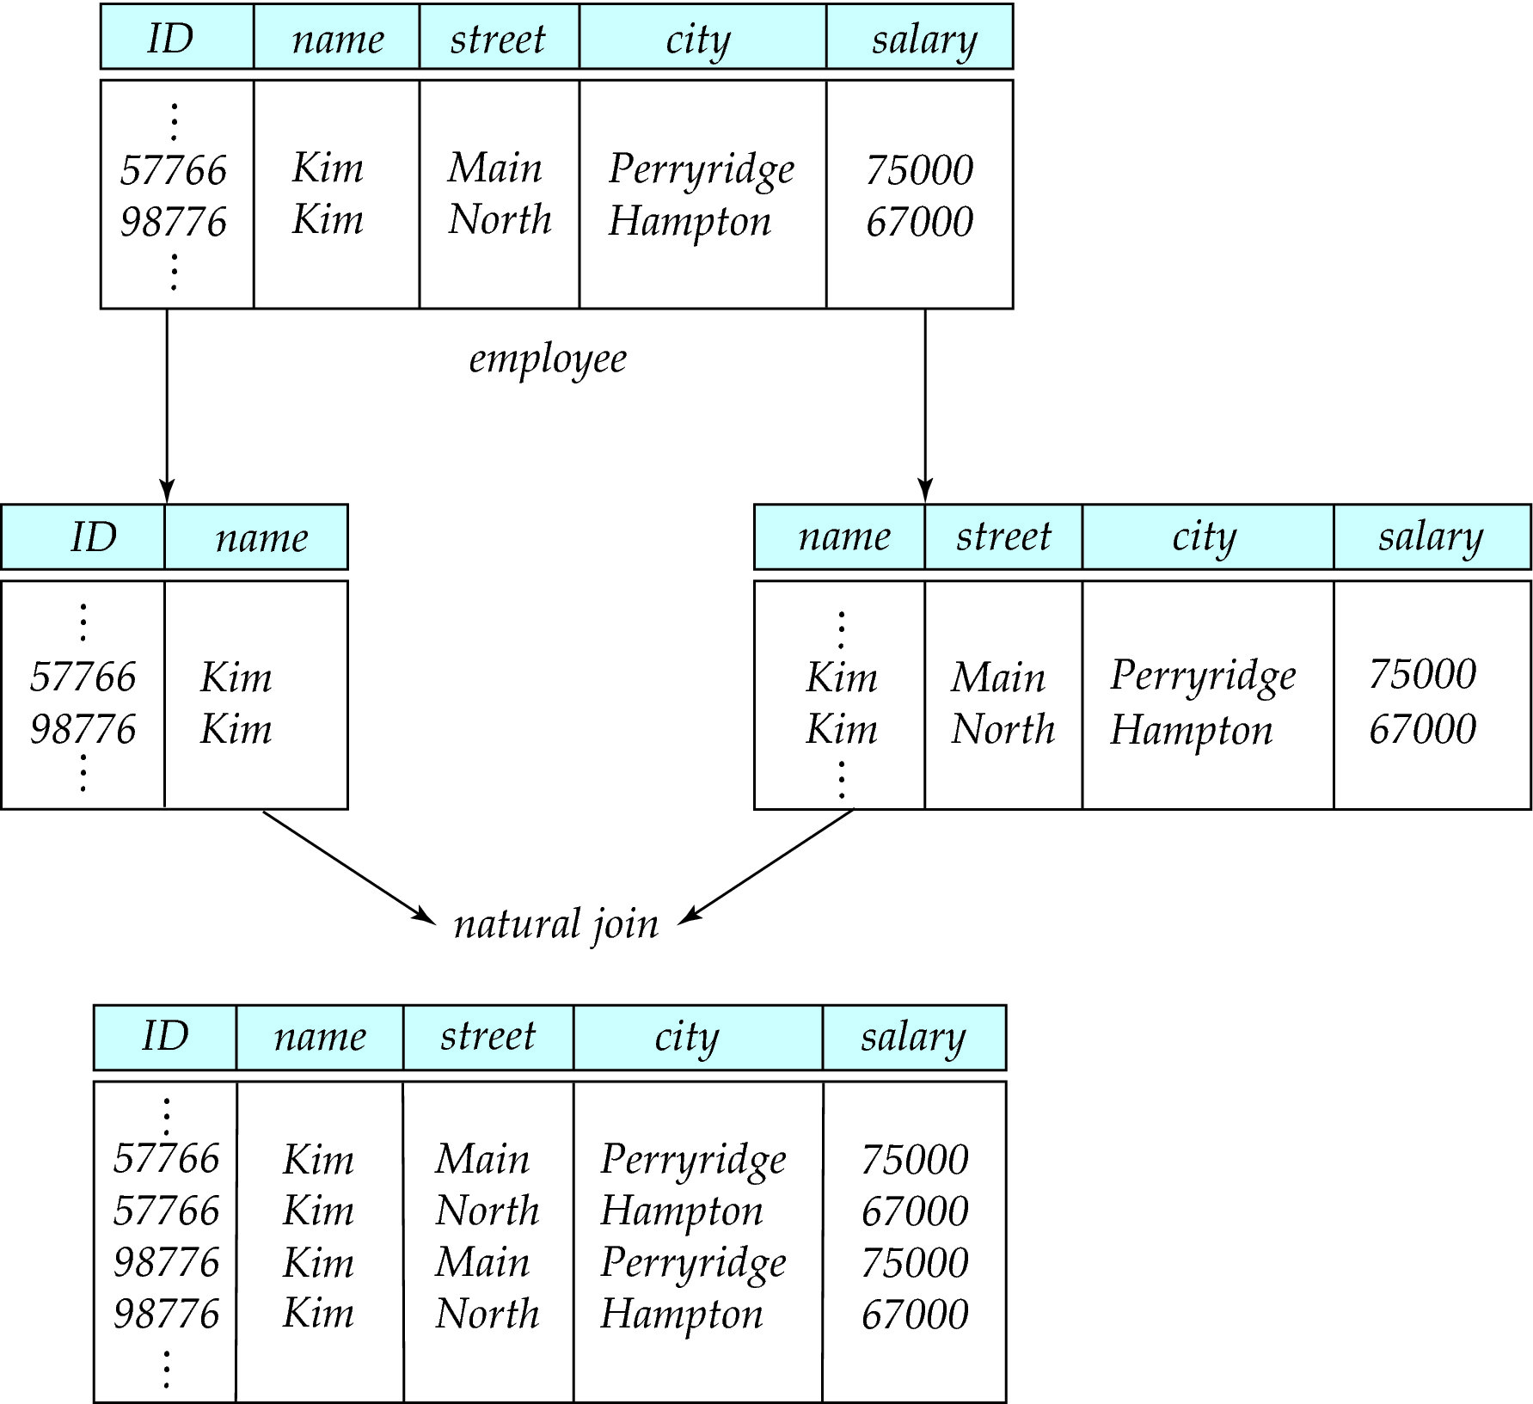
A Lossy Decomposition

Slide 8
lossless decomposition
Let R be a relation schema and let R₁ and R₂ form a
decomposition of R . That is R = R₁ U R₂
We say that the decomposition is a lossless decomposition if
there is no loss of information by replacing R with the two
relation schemas R₁ U R₂
Formally,
∏ _{R1} (r) ∏ _{R2} (r) = r
And, conversely a decomposition is lossy if
r ⊂ ∏ _{R1} (r) ∏ _{R2} (r) = r
Let R be a relation schema and let R₁ and R₂ form a decomposition of R . That is R = R₁ U R₂
We say that the decomposition if there is no loss of information by replacing R with the two relation schemas R₁ U R₂
Formally,
∏ _{R1} (r) ∏ _{R2} (r) = r
And, conversely a decomposition is lossy if
r ⊂ ∏ _{R1} (r) ∏ _{R2} (r) = r

Slide 9
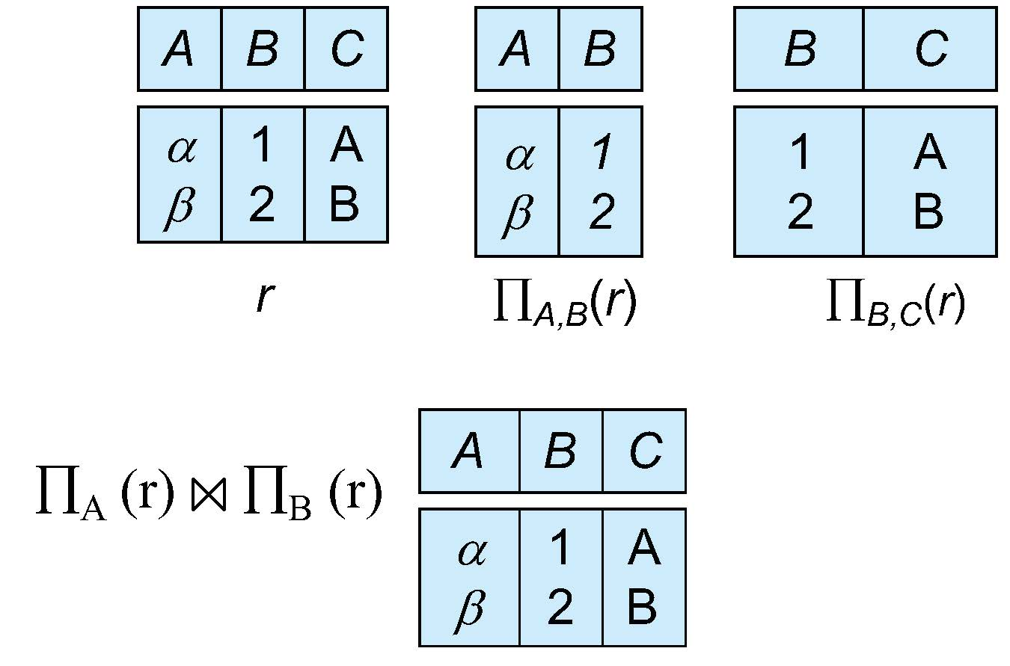
Examples of lossless decomposition
Decomposition of R = (A, B, C) R₁ = (A, B) R₂ = (B, C)
Let R be a relation schema and let R₁ and R₂ form a decomposition of R . That is R = R₁ U R₂
We say that the decomposition if there is no loss of information by replacing R with the two relation schemas R₁ U R₂
Formally,
∏ _{R1} (r) ∏ _{R2} (r) = r
And, conversely a decomposition is lossy if
r ⊂ ∏ _{R1} (r) ∏ _{R2} (r) = r

Slide 10
Normalization Theory
Decide whether a particular relation R is in “good” form.
In the case that a relation R is not in “good” form, decompose it into set
of relations {R₁, R₂, ..., R_{n}} such that
Each relation is in good form
The decomposition is a lossless decomposition
Our theory is based on:
Functional dependencies
Multivalued dependencies
Let R be a relation schema and let R₁ and R₂ form a decomposition of R . That is R = R₁ U R₂
We say that the decomposition if there is no loss of information by replacing R with the two relation schemas R₁ U R₂
Formally,
∏ _{R1} (r) ∏ _{R2} (r) = r
And, conversely a decomposition is lossy if
r ⊂ ∏ _{R1} (r) ∏ _{R2} (r) = r

Slide 11
Functional Dependencies
Let R be a relation schema and let R₁ and R₂ form a decomposition of R . That is R = R₁ U R₂
We say that the decomposition if there is no loss of information by replacing R with the two relation schemas R₁ U R₂
Formally,
∏ _{R1} (r) ∏ _{R2} (r) = r
And, conversely a decomposition is lossy if
r ⊂ ∏ _{R1} (r) ∏ _{R2} (r) = r
There are usually a variety of constraints (rules) on the data in the real
world.
For example, some of the constraints that are expected to hold in a
university database are:
Students and instructors are uniquely identified by their ID.
Each student and instructor has only one name.
Each instructor and student is (primarily) associated with only one
department.
Each department has only one value for its budget, and only one
associated building.

Slide 12
Functional Dependencies (Cont.)
Let R be a relation schema and let R₁ and R₂ form a decomposition of R . That is R = R₁ U R₂
We say that the decomposition if there is no loss of information by replacing R with the two relation schemas R₁ U R₂
Formally,
∏ _{R1} (r) ∏ _{R2} (r) = r
And, conversely a decomposition is lossy if
r ⊂ ∏ _{R1} (r) ∏ _{R2} (r) = r
An instance of a relation that satisfies all such real-world constraints is
called a legal instance of the relation;
A legal instance of a database is one where all the relation instances are
legal instances
Constraints on the set of legal relations.
Require that the value for a certain set of attributes determines uniquely
the value for another set of attributes.
A functional dependency is a generalization of the notion of a key.

Slide 13
Functional Dependencies Definition
Let R be a relation schema
α ⊆ R and β ⊆ R
The functional dependency
α → β holds on R if and only if for any legal relations r(R), whenever
any two tuples t₁ and t₂ of r agree on the attributes α, they also
agree on the attributes β. That is,
t₁[α] = t₂ [α] ⇒ t₁[β ] = t₂ [β ]
Let R be a relation schema and let R₁ and R₂ form a decomposition of R . That is R = R₁ U R₂
We say that the decomposition if there is no loss of information by replacing R with the two relation schemas R₁ U R₂
Formally,
∏ _{R1} (r) ∏ _{R2} (r) = r
And, conversely a decomposition is lossy if
r ⊂ ∏ _{R1} (r) ∏ _{R2} (r) = r
α | β
1 | 2
1 | 2
2 | 4
2 | 4

Slide 14
Functional Dependencies Definition
Let us consider the instance of relation r of the following Figure., to see which
functional dependencies are satisfied.
A → C is satisfied. There are two tuples that have an A value of a1.
These tuples have the same C value-namely c1.
Similarly, the two tuples with an A values of a2 have the same C value , c2.
There are no other pairs of distinct tuples that have the same A value.
So the functional dependency C→A is not satisfied.
Let R be a relation schema and let R₁ and R₂ form a decomposition of R . That is R = R₁ U R₂
We say that the decomposition if there is no loss of information by replacing R with the two relation schemas R₁ U R₂
Formally,
∏ _{R1} (r) ∏ _{R2} (r) = r
And, conversely a decomposition is lossy if
r ⊂ ∏ _{R1} (r) ∏ _{R2} (r) = r
A | B | C | D
a1 | b1 | c1 | d1
a1 | b2 | c1 | d2
a2 | b2 | c2 | d2
a2 | b3 | c2 | d3
a3 | b3 | c2 | d4

Slide 15
Keys and Functional Dependencies
Let R be a relation schema and let R₁ and R₂ form a decomposition of R . That is R = R₁ U R₂
We say that the decomposition if there is no loss of information by replacing R with the two relation schemas R₁ U R₂
Formally,
∏ _{R1} (r) ∏ _{R2} (r) = r
And, conversely a decomposition is lossy if
r ⊂ ∏ _{R1} (r) ∏ _{R2} (r) = r
K is a superkey for relation schema R if and only if K → R
K is a candidate key for R if and only if
K → R, and
for no α ⊂ K, α → R
Functional dependencies allow us to express constraints that cannot be
expressed using superkeys. Consider the schema:
in_dep (ID, name, salary, dept_name, building, budget ).
We expect these functional dependencies to hold:
dept_name→ building
ID → building
but would not expect the following to hold:
dept_name → salary

Slide 16
Trivial Functional Dependencies
Let R be a relation schema and let R₁ and R₂ form a decomposition of R . That is R = R₁ U R₂
We say that the decomposition if there is no loss of information by replacing R with the two relation schemas R₁ U R₂
Formally,
∏ _{R1} (r) ∏ _{R2} (r) = r
And, conversely a decomposition is lossy if
r ⊂ ∏ _{R1} (r) ∏ _{R2} (r) = r
A functional dependency is trivial if it is satisfied by all instances of a
relation.
Example:
ID, name → ID, name → name
A→ A is satisfied by all relations involving attribute A.
All tuple t1 and t2 , t1[A] =t2[A].
Similarly, AB→ A is satisfied by all relations involving attribute A.
In general, α → β is trivial if β ⊆ α

Slide 17
Trivial Functional Dependencies
Let R be a relation schema and let R₁ and R₂ form a decomposition of R . That is R = R₁ U R₂
We say that the decomposition if there is no loss of information by replacing R with the two relation schemas R₁ U R₂
Formally,
∏ _{R1} (r) ∏ _{R2} (r) = r
And, conversely a decomposition is lossy if
r ⊂ ∏ _{R1} (r) ∏ _{R2} (r) = r
It is important to realize that an instance of a relation may satisfy some functional
dependencies that are not required to hold on the relation’s schema.
In the instance of the classroom relation of Figure.
Room_number → capacity is satisfied.
However, two classrooms in different buildings can have the same room number
but with different room capacity.
Room_number → capacity is not satisfied.
building | Room_number | Capacity
Packard | 101 | 500
Painter | 514 | 10
Taylor | 3128 | 70
Watson | 100 | 30
Watson | 120 | 50

Slide 18
Closure of a Set of Functional Dependencies
Let R be a relation schema and let R₁ and R₂ form a decomposition of R . That is R = R₁ U R₂
We say that the decomposition if there is no loss of information by replacing R with the two relation schemas R₁ U R₂
Formally,
∏ _{R1} (r) ∏ _{R2} (r) = r
And, conversely a decomposition is lossy if
r ⊂ ∏ _{R1} (r) ∏ _{R2} (r) = r
Given a set F set of functional dependencies, there are certain other
functional dependencies that are logically implied by F.
If A → B and B → C, then we can infer that A → C
etc.
The set of all functional dependencies logically implied by F is the
closure of F.
We denote the closure of F by F⁺.

Slide 19
Use of Functional Dependencies
Let R be a relation schema and let R₁ and R₂ form a decomposition of R . That is R = R₁ U R₂
We say that the decomposition if there is no loss of information by replacing R with the two relation schemas R₁ U R₂
Formally,
∏ _{R1} (r) ∏ _{R2} (r) = r
And, conversely a decomposition is lossy if
r ⊂ ∏ _{R1} (r) ∏ _{R2} (r) = r
We use functional dependencies to:
To test relations to see if they are legal under a given set of functional
dependencies.
If a relation r is legal under a set F of functional dependencies, we
say that r satisfies F.
To specify constraints on the set of legal relations
We say that F holds on R if all legal relations on R satisfy the set
of functional dependencies F.
Note: A specific instance of a relation schema may satisfy a functional
dependency even if the functional dependency does not hold on all legal
instances.
For example, a specific instance of instructor may, by chance, satisfy name → ID.

Slide 20
Lossless Decomposition
Let R be a relation schema and let R₁ and R₂ form a decomposition of R . That is R = R₁ U R₂
We say that the decomposition if there is no loss of information by replacing R with the two relation schemas R₁ U R₂
Formally,
∏ _{R1} (r) ∏ _{R2} (r) = r
And, conversely a decomposition is lossy if
r ⊂ ∏ _{R1} (r) ∏ _{R2} (r) = r
We can use functional dependencies to show when certain decomposition are lossless.
For the case of R = (R₁, R₂), we require that for all possible relations r on schema R
r = ∏_{R1} (r ) ∏_{R2} (r )
A decomposition of R into R₁ and R₂ is lossless decomposition if at least one of the following dependencies is in F⁺:
R₁ ∩ R₂ → R₁
R₁ ∩ R₂ → R₂
The above functional dependencies are a sufficient condition for lossless join decomposition; the dependencies are a necessary condition only if all constraints are functional dependencies

Slide 21
Example
Let R be a relation schema and let R₁ and R₂ form a decomposition of R . That is R = R₁ U R₂
We say that the decomposition if there is no loss of information by replacing R with the two relation schemas R₁ U R₂
Formally,
∏ _{R1} (r) ∏ _{R2} (r) = r
And, conversely a decomposition is lossy if
r ⊂ ∏ _{R1} (r) ∏ _{R2} (r) = r
R = (A, B, C) F = {A → B, B → C)
R₁ = (A, B), R₂ = (B, C)
Lossless decomposition:
R₁ ∩ R₂ = {B} and B → BC
R₁ = (A, B), R₂ = (A, C)
Lossless decomposition:
R₁ ∩ R₂ = {A} and A → AB
Note:
B → BC
is a shorthand notation for
B → {B, C}

Slide 22
Dependency Preservation
Database consistency constraints: primary key constraints, functional
dependencies, check constraints, assertions and triggers.
Testing these constraints each time the database is updated can be costly.
It is useful to design the database in a way that constraints can be tested efficiently.
If testing a functional dependency can be done by considering just one relation,
then the cost of testing this constraint is low
When decomposing a relation it is possible that it is no longer possible to do the
testing without having to perform a Cartesian Produced.
A decomposition that makes it computationally hard to enforce functional
dependency is said to be NOT dependency preserving.
Let R be a relation schema and let R₁ and R₂ form a decomposition of R . That is R = R₁ U R₂
We say that the decomposition if there is no loss of information by replacing R with the two relation schemas R₁ U R₂
Formally,
∏ _{R1} (r) ∏ _{R2} (r) = r
And, conversely a decomposition is lossy if
r ⊂ ∏ _{R1} (r) ∏ _{R2} (r) = r

Slide 23
Dependency Preservation Example
Let R be a relation schema and let R₁ and R₂ form a decomposition of R . That is R = R₁ U R₂
We say that the decomposition if there is no loss of information by replacing R with the two relation schemas R₁ U R₂
Formally,
∏ _{R1} (r) ∏ _{R2} (r) = r
And, conversely a decomposition is lossy if
r ⊂ ∏ _{R1} (r) ∏ _{R2} (r) = r
For example: A student may have only one advisor.
The relationship set advisor being many-to-one from student to advisor.
An instructor can be associated with only a single department.
A student may have more than one advisor, but no more than one from a given
department’
schema: dept_advisor(s_ID, i_ID, department_name)
With function dependencies:
i_ID → dept_name
s_ID, dept_name → i_ID
In the above design we are forced to repeat the department name once for each
time an instructor participates in a dept_advisor relationship.
To fix this, we need to decompose dept_advisor
Any decomposition will not include all the attributes in
s_ID, dept_name → i_ID
Thus, the composition NOT be dependency preserving

Slide 24
Next Lecture
Normal Forms

